Slide 1

Automatic Attendance System: The Future of Tracking
Team Members:
Kavie Nivesh V -ra2011003010187
Aniruddh y s -RA2011003010141
Akshay M S -ra2011003010173

Slide 2
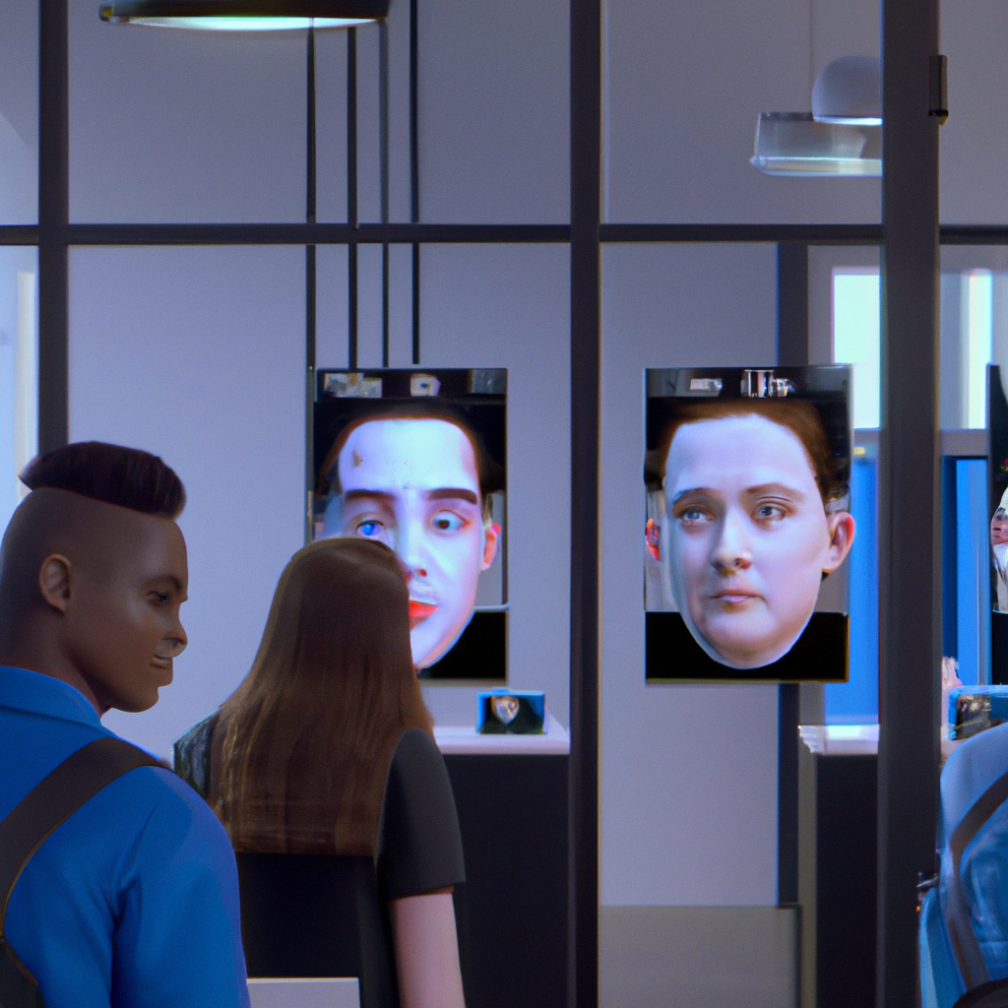
Introduction
Automatic attendance systems have been around for quite some time, but with the advent of new artificial intelligence technology like Convolution Neural Network (CNN), these systems have become more accurate and efficient.
Facial recognition is one such technology that has been integrated into automatic attendance systems. With the help of CNN, facial recognition can be made even more effective, making it an ideal solution for organizations looking to improve their attendance tracking.

Slide 3

Objectives
The objective of this project is to develop face recognition based automated student attendance system. Expected achievements in order to fulfill the objectives are:
• To detect the face segment from the video frame.
• To extract the useful features from the face detected.
• To classify the features in order to recognize the face detected.
• To record the attendance of the identified student.
To generate report and send notifications for attendance.
To make the attendance-taking process even more convenient, this automatic attendance system can be integrated with a mobile app.

Slide 4
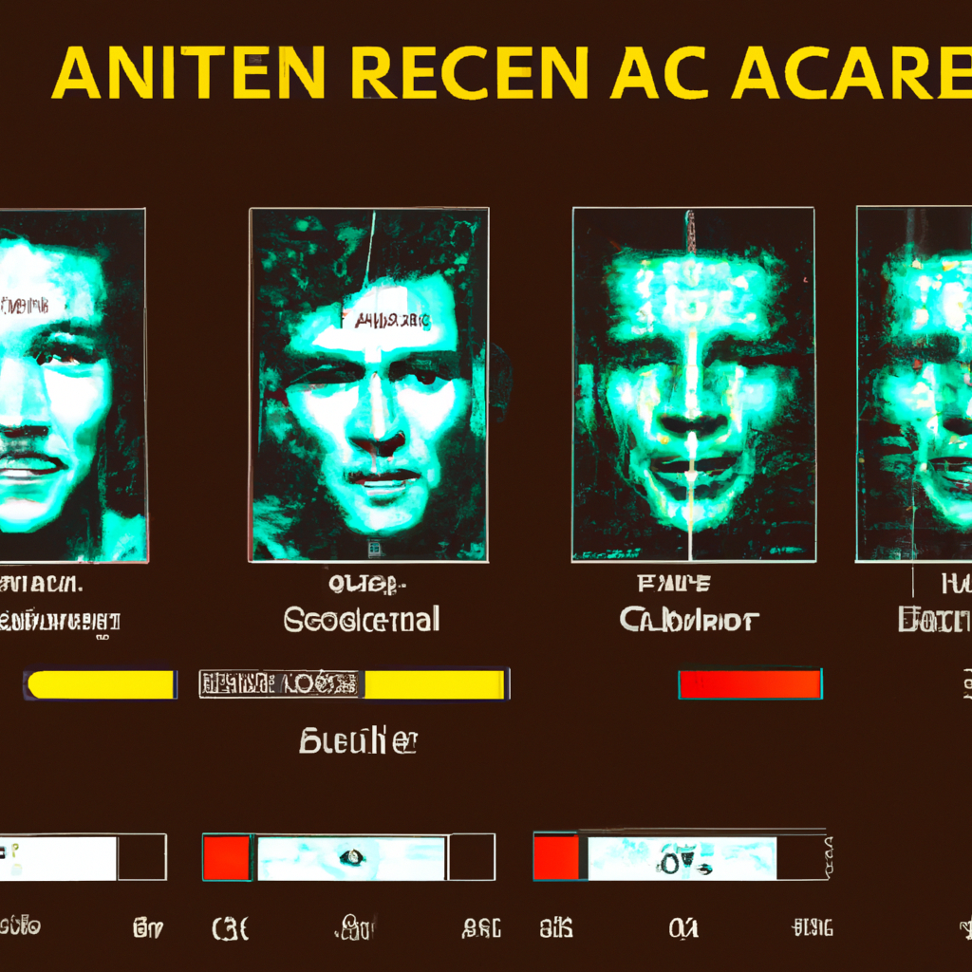
Literature Review
Previous facial recognition techniques have limitations such as low accuracy rates, difficulty in recognizing faces under different lighting conditions, and inability to detect spoofing attacks.
To address these limitations, CNN-based facial recognition systems have been developed. These systems use deep learning algorithms to learn facial features and can recognize faces even under challenging conditions. They have shown high accuracy rates and are resistant to spoofing attacks.

Slide 5
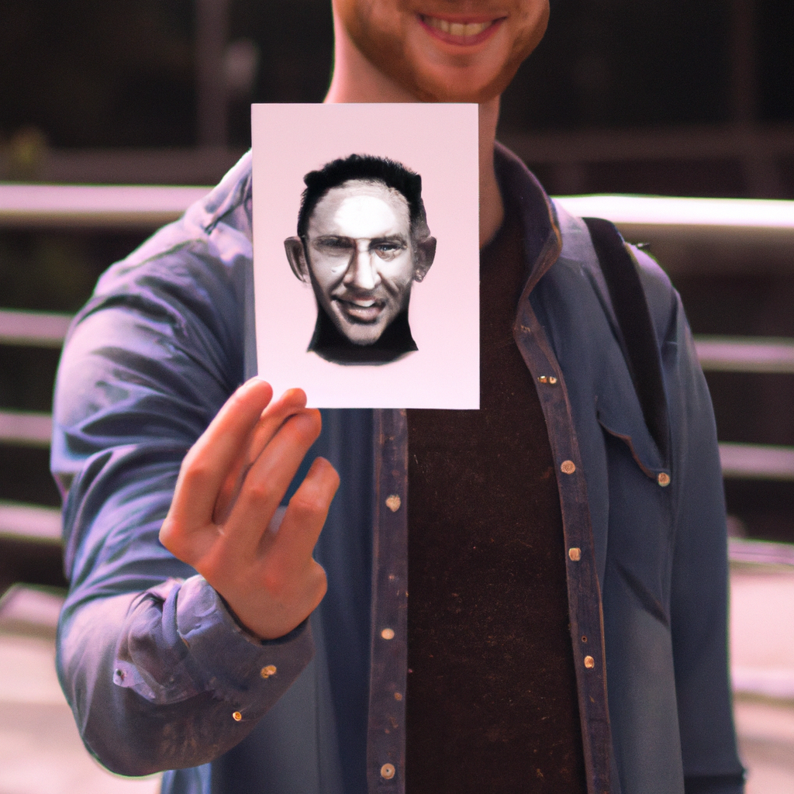
Limitations
Traditional facial recognition techniques rely on feature extraction methods that are sensitive to variations in lighting and facial expressions. This makes them less accurate and prone to errors.
Additionally, these techniques are vulnerable to spoofing attacks where an imposter can fool the system by presenting a fake image or video of the authorized person's face.

Slide 6
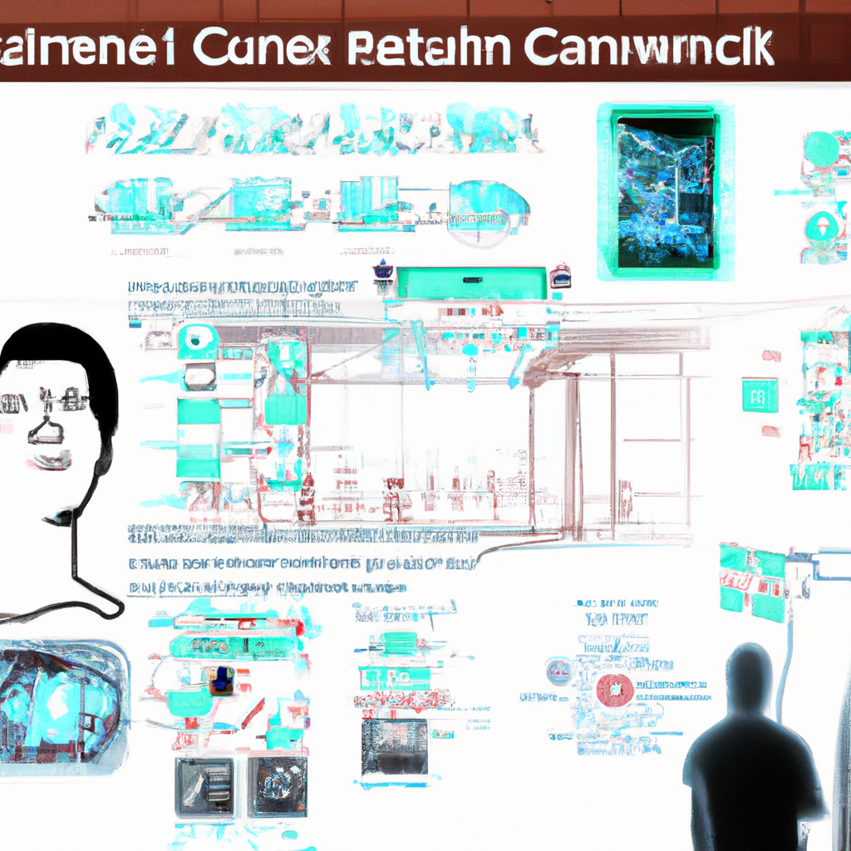
Proposals
To overcome the limitations of previous facial recognition techniques, a CNN-based automatic attendance system has been proposed. This system uses deep learning algorithms to learn facial features and can recognize faces even under challenging conditions.
New features such as in-time and out-time recording have been added to improve the system's functionality and usability. In addition, measures have been taken to prevent spoofing attacks by using liveness detection techniques.

Slide 7
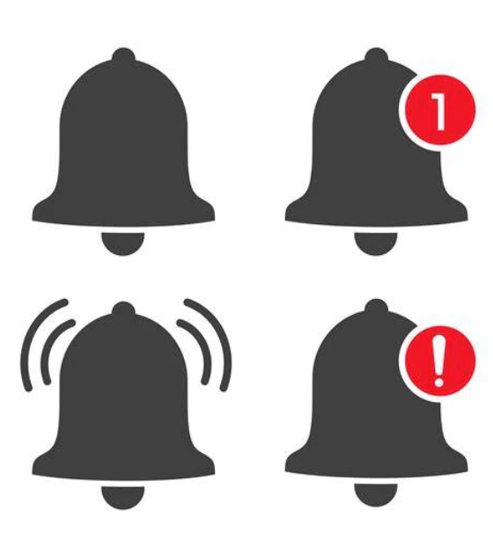
Automatic Time counting and notifications:
When the students enter the class the face recognition system recognizes the face and starts a timer for that particular student and if the student is present in the class for more than 40 minutes he/she would get the attendance for that particular class.
If the student comes to the class ,a notification will be sent to their parents that the student is late.
Also when the student does not attend any class a notification will automatically be sent to their parents.

Slide 8

Predictive Analytics
Another exciting feature of this automatic attendance system is its use of predictive analytics. By analyzing attendance data over time, the system can identify patterns and trends that may indicate potential issues such as chronic absenteeism or tardiness. This allows teachers and administrators to intervene early and provide support to students who may be struggling.
Furthermore, the system can generate reports that provide insights into attendance patterns across different classes, grade levels, and even entire schools. This information can be used to identify areas for improvement and inform decision-making around resource allocation and scheduling.

Slide 9

Mobile App Integration
To make the attendance-taking process even more convenient, this automatic attendance system can be integrated with a mobile app. Students can use the app to check-in when they arrive in class, eliminating the need for physical sign-in sheets or cards. Additionally, the app can send push notifications to remind students of upcoming classes and deadlines.
Teachers and administrators can also use the app to access attendance data in real-time, view reports, and communicate with students and parents. This mobile integration makes the attendance process more streamlined and accessible for everyone involved.

Slide 10

Security and Privacy
As with any technology that involves personal data, security and privacy are of utmost importance. This automatic attendance system uses state-of-the-art encryption and security protocols to ensure that student data is protected from unauthorized access or theft.
Additionally, the system is designed to be fully compliant with relevant data protection regulations such as GDPR and CCPA. Students and parents can rest assured that their personal information is being handled responsibly and transparently.

Slide 11
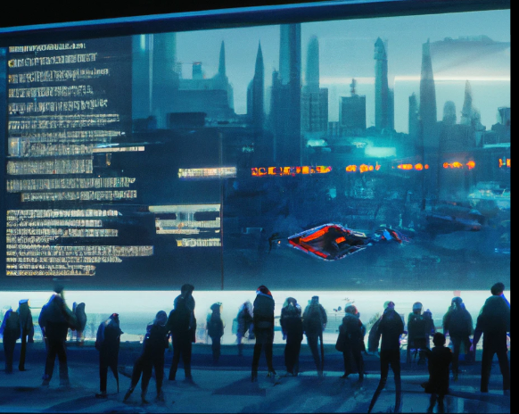
Conclusion
In conclusion, the proposed automatic attendance system using CNN-based facial recognition technology is a fast and accurate way to record attendance. It overcomes the limitations of traditional attendance systems and previous facial recognition techniques.
With the added features of in-time and out-time recording and liveness detection measures, this system provides an enhanced user experience and improved security. It has the potential to revolutionize attendance recording processes in educational institutions and other organizations.
With facial recognition technology, predictive analytics, mobile app integration, and robust security measures, this system is paving the way for a more efficient and effective approach to attendance tracking. As technology continues to advance, we can expect even more exciting developments in this field.

